Slide 1


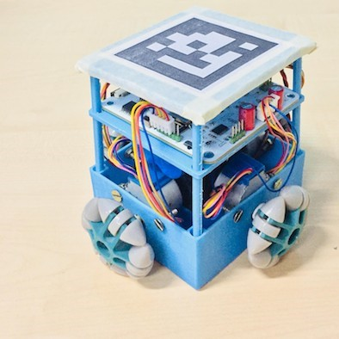
SPRINTER
A Discrete Locomotion Robot for Precision Swarm Printing
We present a discrete locomotion printing robot, the SPRINTER , capable of collective printing
and a centralized printing system, which
closely resembles a parallelized
inkjet printer.

Slide 2

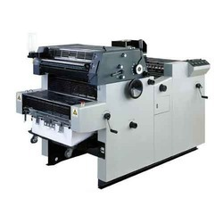
INTRODUCTION
OLD PRINTING MACHINE SYSTEM
CONS:
Large size
Time consuming
Power consuming
High cost
Constant need to replace film and plates
Folding and cutting press material

Slide 3
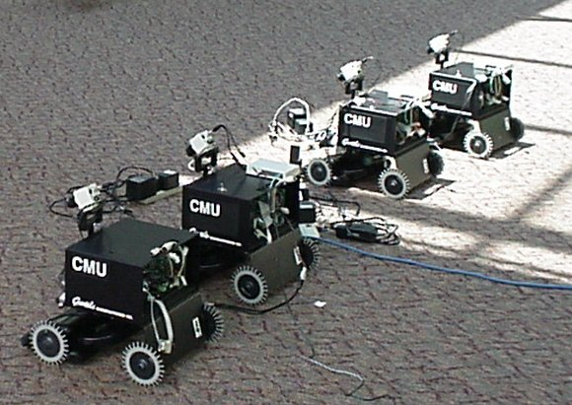
INTRODUCTION
MULTI-ROBOT SYSTEMS (MRS)
Cost effective as compared to building a single costly robot with all the capabilities.
Systems are usually decentralized.
Fault tolerant
Improve the reliability
Robustness of the system
Providing flexibility to task execution
Potentially wide set of applications

Slide 4
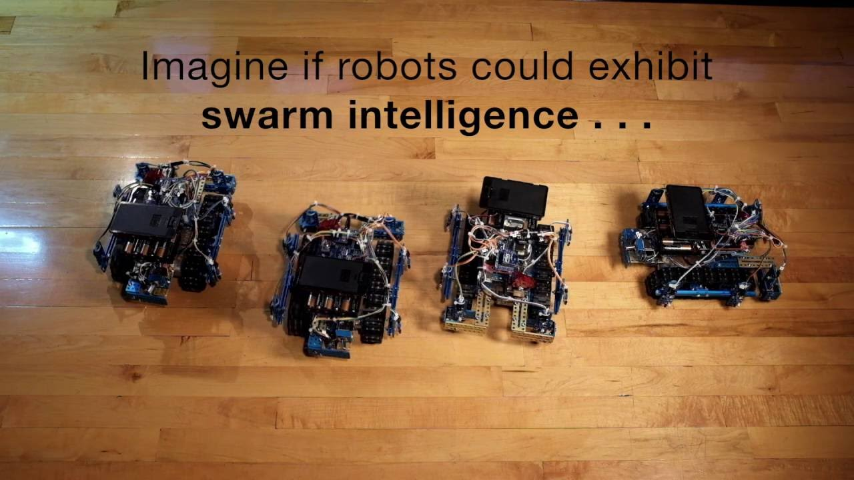
SWARM TECHNOLOGY
Coordination of multiple robots as a system which consists of large numbers of mostly simple physical robots.
A desired collective behavior emerges from the interactions between the robots and interactions of robots with the environment.
This approach emerged on the field of artificial swarm intelligence.

Slide 5
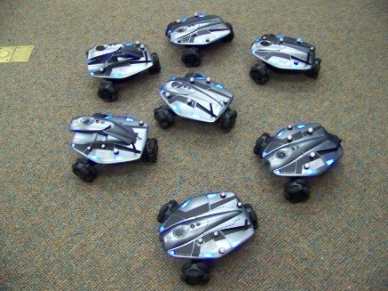
OBJECTIVE
THE SPRINTER ROBOT :
Target to improvise the present graphic printing technology.
Introduce cooperative printing methods using multi-robot systems.
Overcome quadratic dependency of printing time on the size of print in modern day printing systems.
Targets at controlling this dependency by parallely printing a graphic with a group of robots.

Slide 6
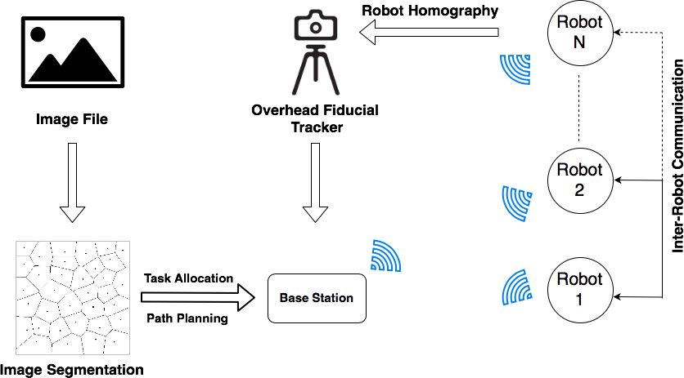
ARCHITECTURE
CELLULARIZATION:
The SPRINTER
testbed performs
distributed printing
based on principle
of segmenting an
image.
The SPRINTER robot was equipped with only a black inkjet cartridge.
The process flow of the SPRINTER testbed.

Slide 7
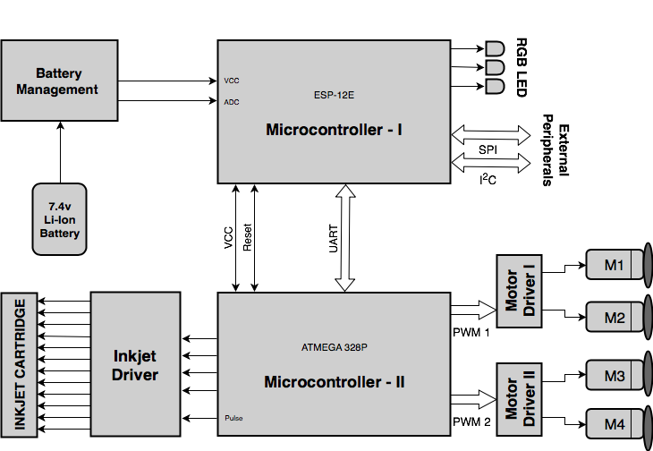
Hardware Architecture
It uses dual microcontroller architecture for handling communication and motor control separately.
Inkjet Driver/Printer cartridge : to deploy the printing mechanism
Power Requirements: 7.4v 2s Lithium Polymer battery
The basic hardware architecture of SPRINTER Robot.

Slide 8
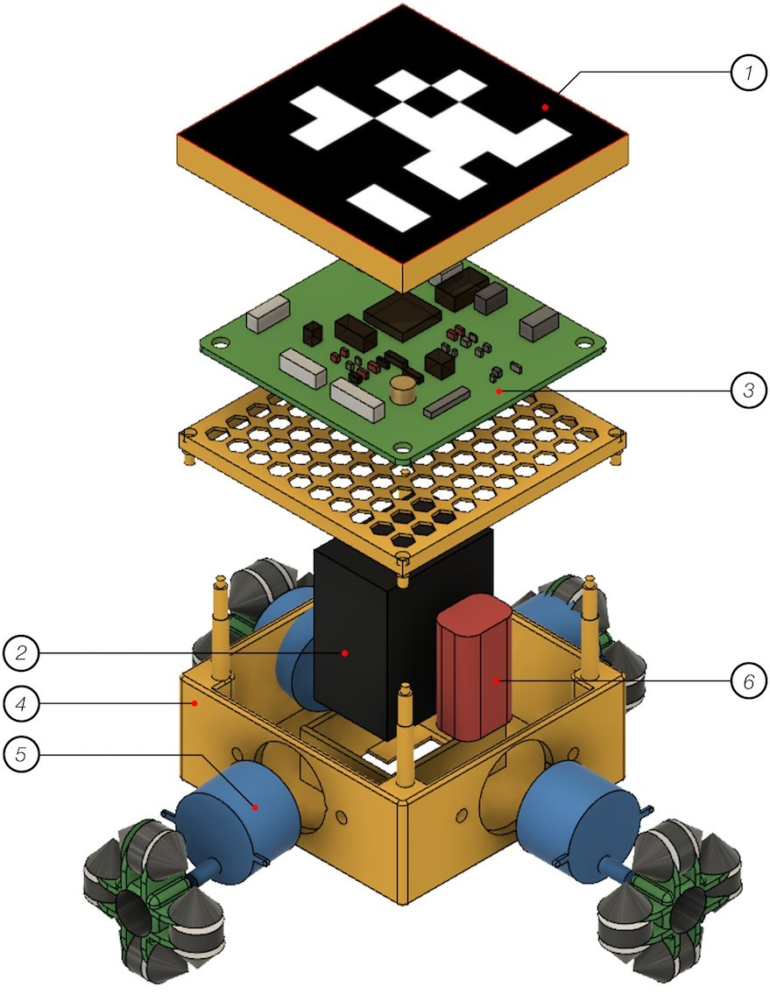
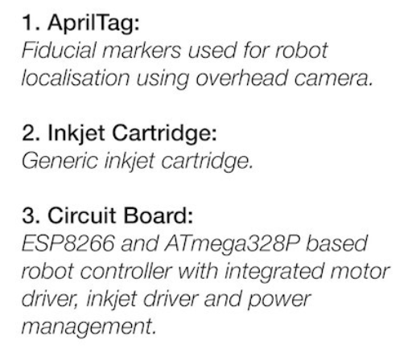
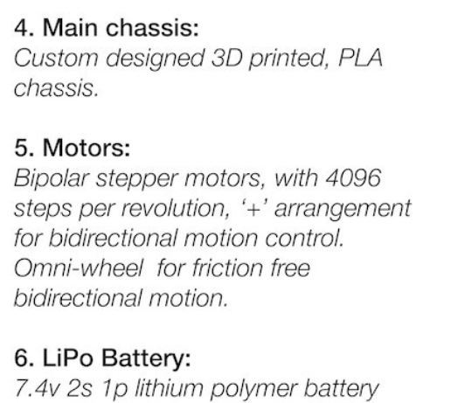
The exploded view of the SPRINTER robot

Slide 9
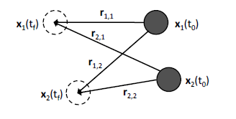
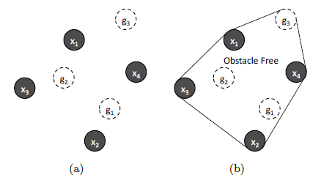
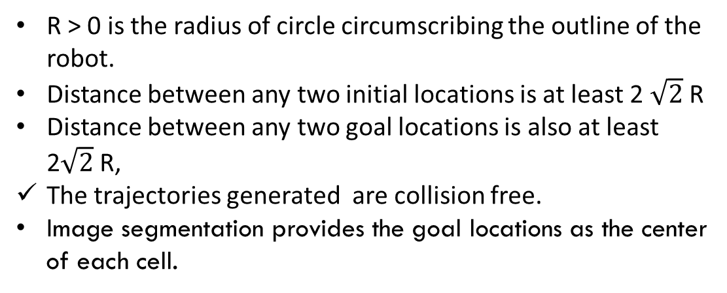
Task Allocation
Guaranteeing collision free trajectories for homogeneous robots.
Problem: allocating N robots to N goal locations in a 2-dimensional Euclidean-space.
The initial positions are random locations on the testbed, where the robots are placed at t = 0.
R > 0 is the radius of circle circumscribing the outline of the robot.
Distance between any two initial locations is at least 2 $\sqrt{2}$R
Distance between any two goal locations is also at least 2$\sqrt{2}$R,
The trajectories generated are collision free.
Image segmentation provides the goal locations as the center
of each cell.

Slide 10


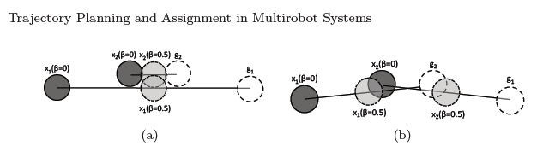
Trajectory Planning and Assignment in Multirobot Systems
CENTRALIZED ALGORITHM:
Centralized optimization seeks to collision-free trajectories
for all agents in the system such that each goal state is occupied
by an agent
1.) The Minimum Sum of Distances Trajectory :
-minimizing the sum of distances traveled by all agents.
2.) The Minimum Velocity Trajectory :
-minimize the sum of the integral of velocity squared traveled by all agents.

Slide 11
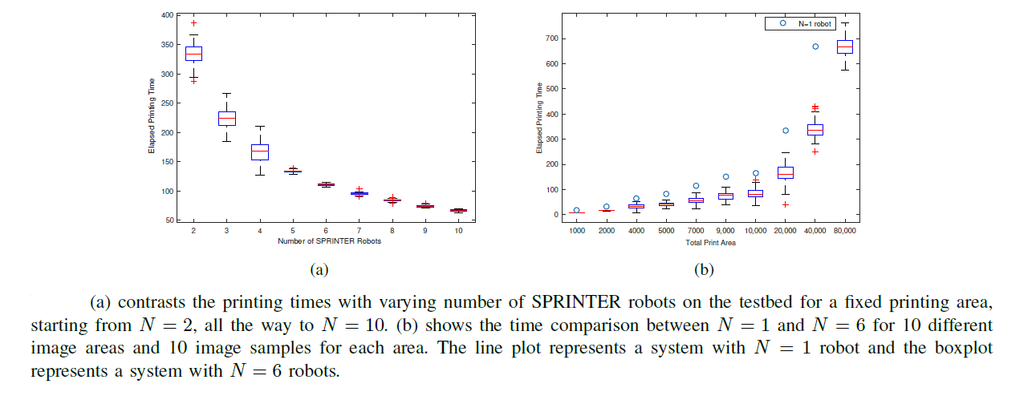
CONCLUSION
The system uses the concept of cellularization of images based on a cost function. Each cell is then assigned to the robots using a centralized task allocation algorithm which also ensures collision avoidance.
As we increase the number of robots, the time taken to print a given area decreases significantly.

Slide 12

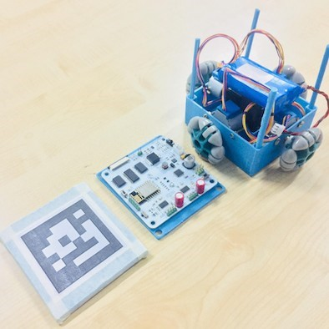
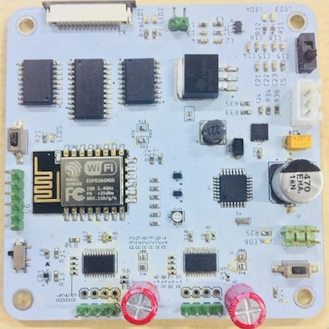
prototype
(a) shows the actual SPRINTER robot used in the study of the testbed.
(b) shows the three layers of robot.
(c)shows custom circuit board that controls electronics of the SPRINTER.

Slide 13
FUTURE GOALS AND APPLICATIONS
As expected, the SPRINTER system outperforms traditional
printing systems, in terms of needed time.
The algorithm yields suboptimal assignments but safe trajectories.
Future work will aim at realizing an extensive evaluation campaign, considering more complex images, possibly with colors, and larger groups of robots.

Slide 14

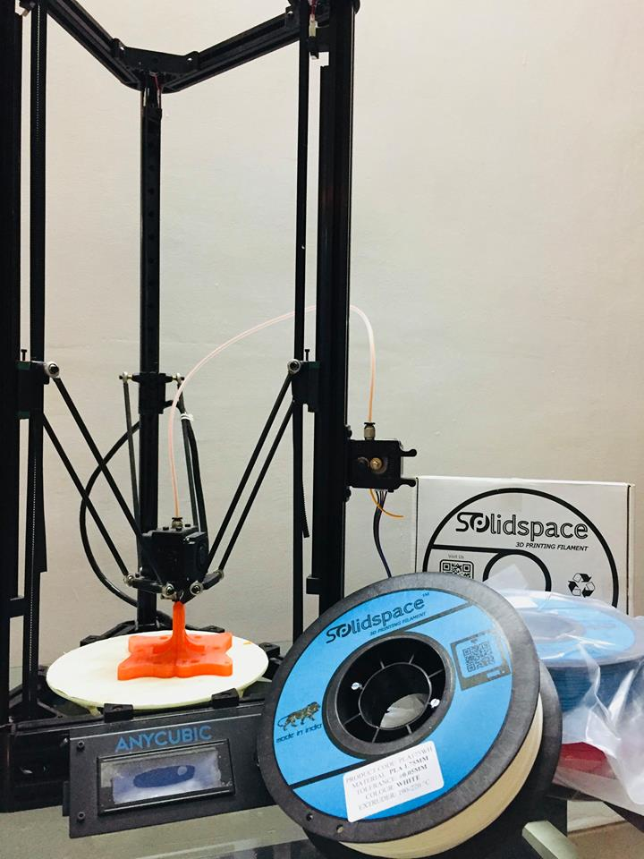

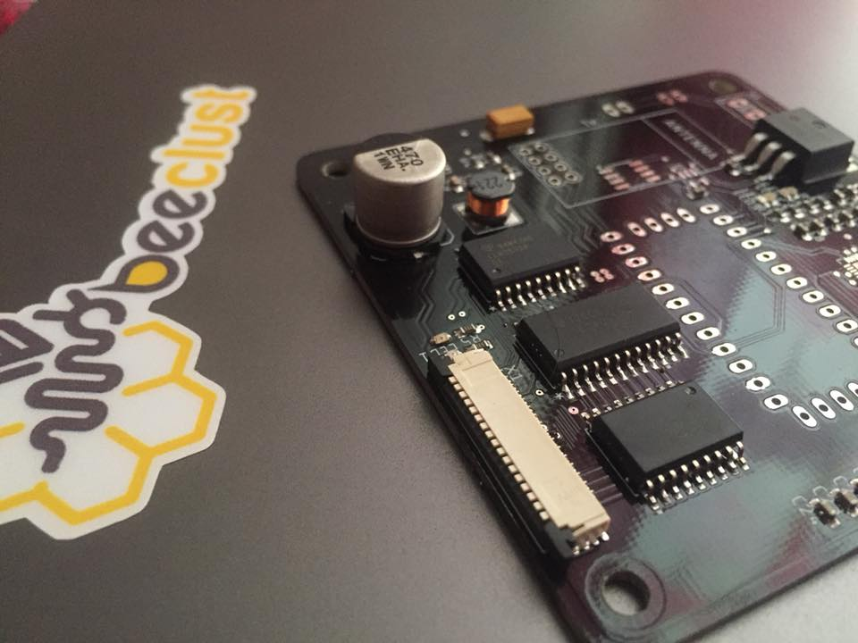

THANK-YOU
Our manufacturing partner
pcbway.com
www.facebook.com/Beeclustlab/

